Slide 1
DIFFERENTIATED SERVICE DELIVERY FOR HIV IN NIGERIA
A SEMINAR PRESENTATION
EZE-EMIRI CHIDINMA NNEKA
G2019/SPH/PHD/FT/EPID/004
APRIL 2023

Slide 2
TABLE OF CONTENTS
Introduction
HIV Epidemic Response: Where We Are
HIV Care Continuum
Problem Statement
Achieving Optimal Clinical Outcome
Intervention: Differentiated Service Delivery (DSD)
DSD Building Blocks
DSD Models: Prevention and Integration
DSD Model: Testing
Elements of dHTS
Building Blocks of dHTS
DSD Model: Treatment
Elements and Building Blocks of dART
dART Sub Models
Review of DSD Implementation in Nigeria
Identifying the Gap
Results Highlights
Conclusion And Recommendation
References

Slide 3



HIV EPIDEMIC RESPONSE: WHERE WE ARE
Global
> 38 Million
Nigeria
> 1.9 Million
HIV
Statistics
UNAIDS 95-95-95
Target

Slide 4





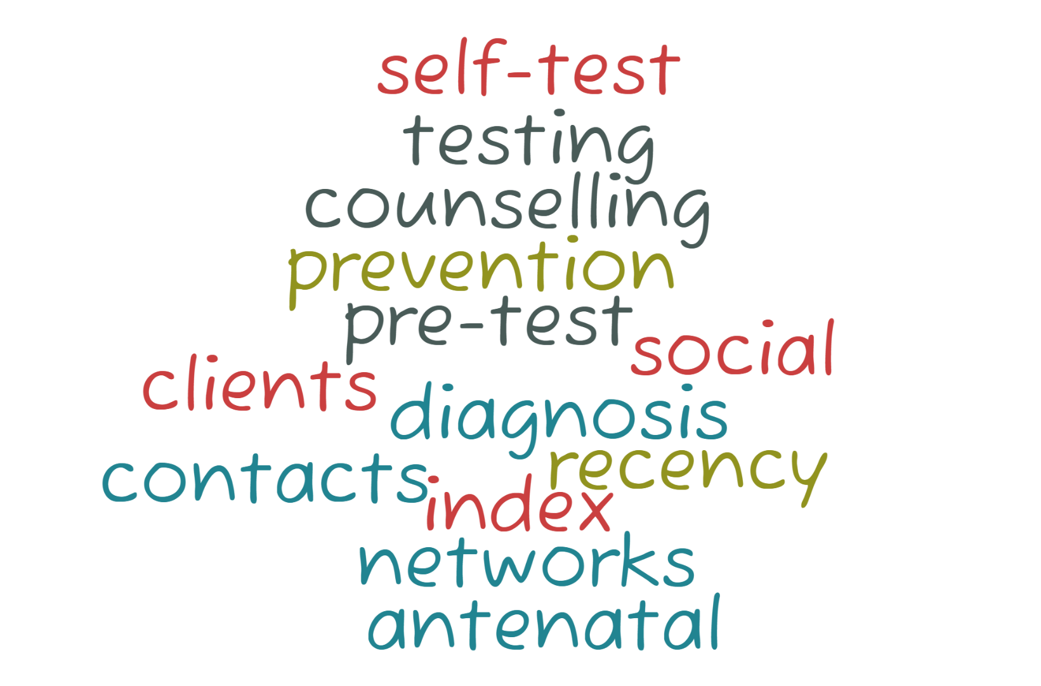
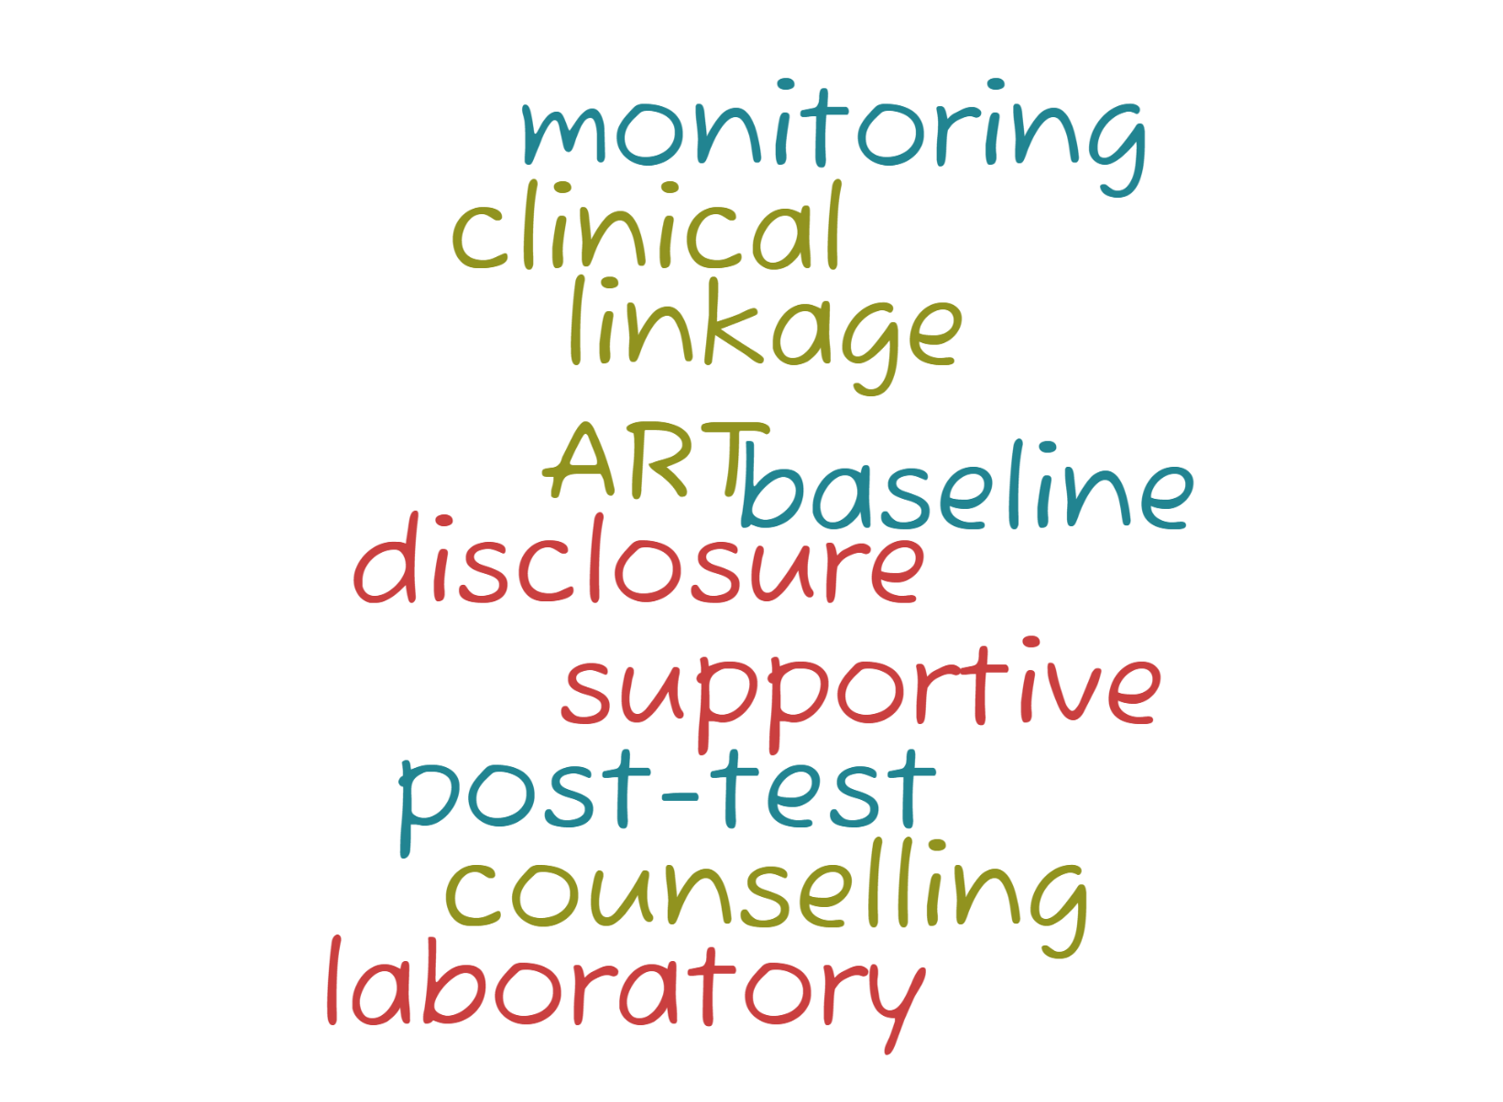
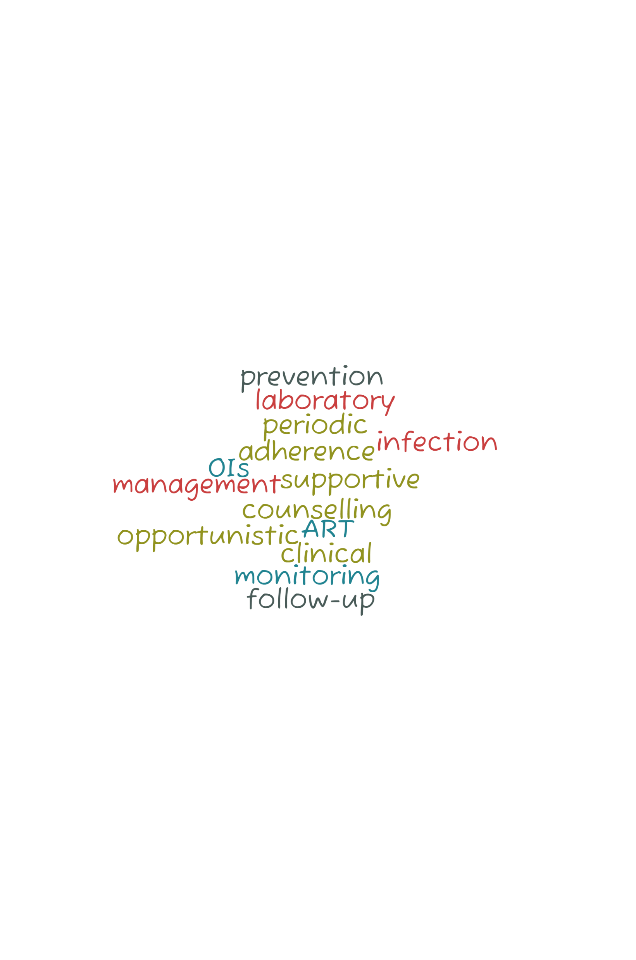
HIV CARE CONTINUUM
The stages from HIV diagnosis to achieving and maintaining viral suppression through care and treatment with ART | An individual-level tool to assess care outcomes | Informs existing service gaps to help develop strategies for better support of PLHIV
Thematic Areas
HIV TESTING SERVICES
ANTIRETROVIRAL THERAPY
Diagnosed with HIV
Received HIV Care
Maintained Viral Suppression
Care
Linked to Care
Retained in Care
Services

Slide 5
TABLE OF CONTENTS
Introduction
HIV Epidemic Response: Where We Are
HIV Care Continuum
Problem Statement
Achieving Optimal Clinical Outcome
Intervention: Differentiated Service Delivery (DSD)
DSD Building Blocks
DSD Models: Prevention and Integration
DSD Model: Testing
Elements of dHTS
Building Blocks of dHTS
DSD Model: Treatment
Elements and Building Blocks of dART
dART Sub Models
Review of DSD Implementation in Nigeria
Identifying the Gap
Results Highlights
Conclusion And Recommendation
References

Slide 6
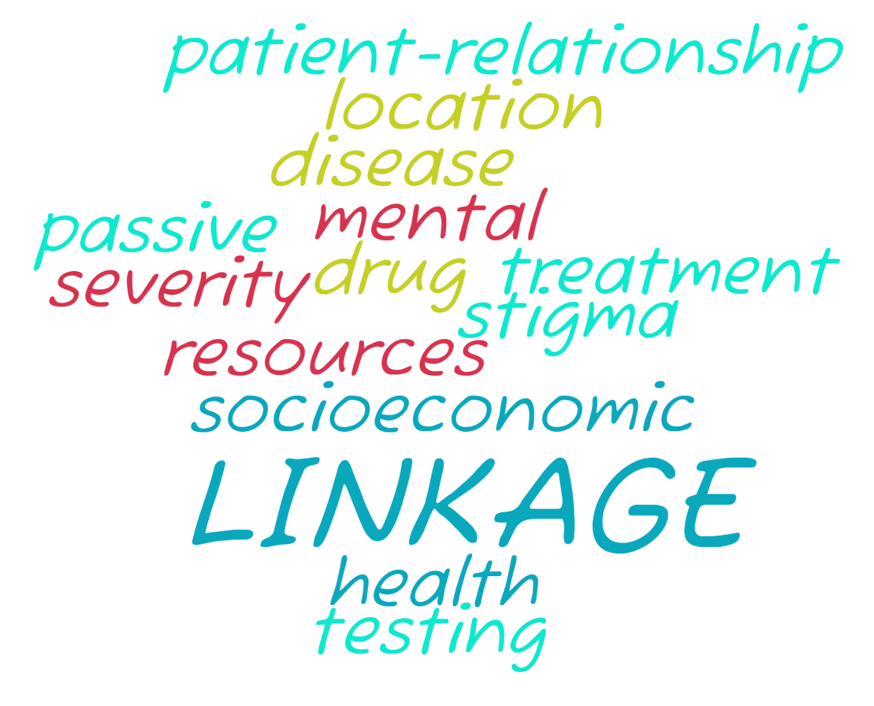
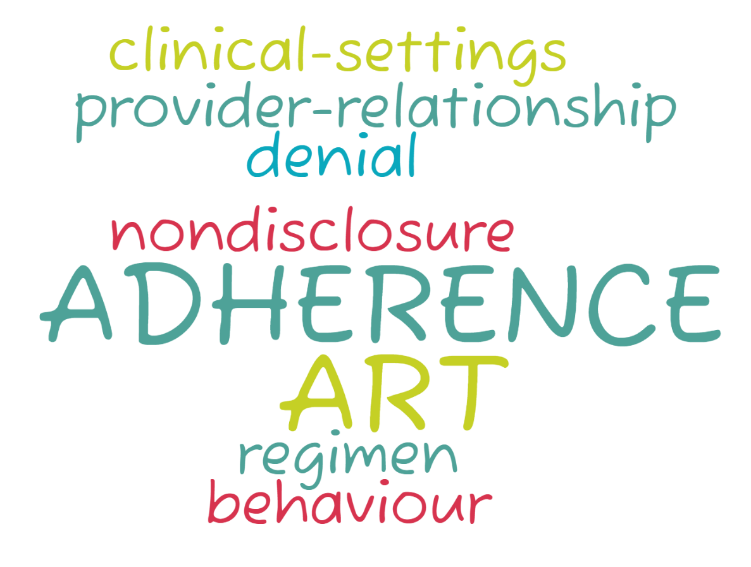

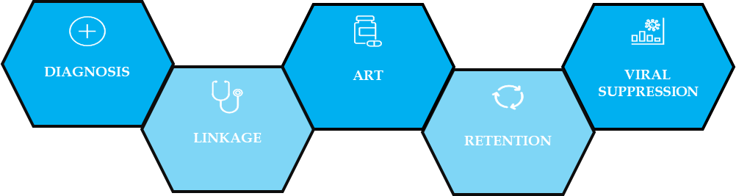

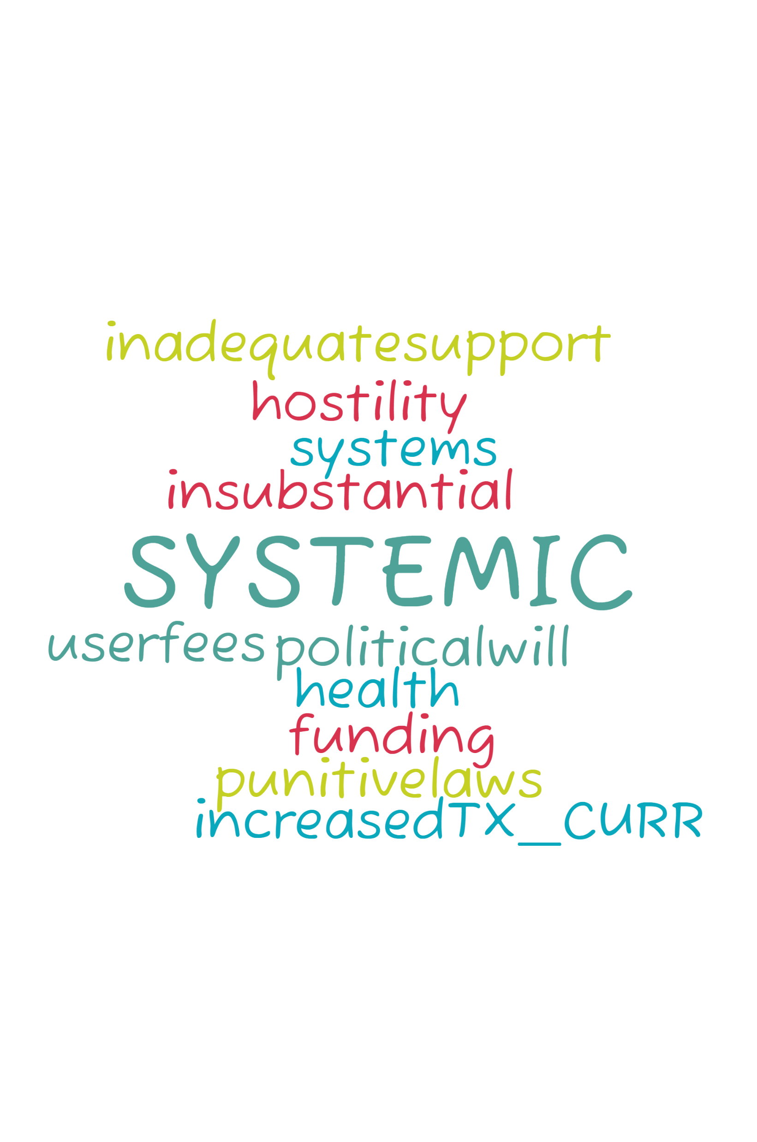
ACHIEVING OPTIMAL CLINICAL OUTCOME
Early Linkage
Adherence
Retention
VIRAL SUPPRESSION
TREATMENT GOAL

Slide 7
TABLE OF CONTENTS
Introduction
HIV Epidemic Response: Where We Are
HIV Care Continuum
Problem Statement
Achieving Optimal Clinical Outcome
Intervention: Differentiated Service Delivery (DSD)
DSD Building Blocks
DSD Models: Prevention and Integration
DSD Model: Testing
Elements of dHTS
Building Blocks of dHTS
DSD Model: Treatment
Elements and Building Blocks of dART
dART Sub Models
Review of DSD Implementation in Nigeria
Identifying the Gap
Results Highlights
Conclusion And Recommendation
References

Slide 8



DIFFERENTIATED SERVICE DELIVERY
A person-centred approach to HIV service delivery | Simplifies and adapts HIV services | Meets the needs of PLHIV and HIV vulnerable people | Reducing unnecessary burdens on the health system
Differentiated Testing, dHTS
Differentiated ART delivery, dART
Diagnosis
Treatment
Virally
Suppressed
Prevention
Linkage
Retention
Integration
Differentiated Care applies along the HIV Continuum of Care

Slide 9



DSD BUILDING BLOCKS
WHAT (Clinical, Lab, Psychosocial Services)
WHEN (How Often)
Monthly
Bimonthly
Quarterly
Biannually
Annually
ART initiation & refill
Clinical Monitoring
Adherence Support
Lab Test
Opportunistic Infection
PLHIV
Service Intensity
Service Frequency
Service Location
Health Worker Cadre
WHERE (Location)
WHO (Service Provider)
Physician
Nurse
Pharmacist
Community health Worker
Family, Friend, Peer
Clinical Officer
HIV Clinic
Hospital
Primary Care Clinic
Community
Home

Slide 10
PREVENTION
TESTING
TREATMENT
INTEGRATION
DSD MODELS
WHAT
PrEP Initiation/Refill
Clinical Monitoring
Adherence Support
Screening & Treatment (STI, HCV, HBV, PT)
Contraceptives
Condoms & Lubricants
WHEN
Monthly
3 monthly
6 monthly
WHERE
HIV or other clinics
Hospital
Community
Courier
Pharmacy
WHO
Physician
Clinical Officer
Nurse
Pharmacist
Community HCW
Patient /Peer /Family
Counsellor
TB Preventative Therapy
Family Planning
Chronic Treatment for Non-Communicable Diseases (NCDs)
BUILDING BLOCKS
Young Women & Adolescent Girls + Male Partners
Key Population
Condom
VMMC
PrEP
PREVENTIONPILLARS

Slide 11
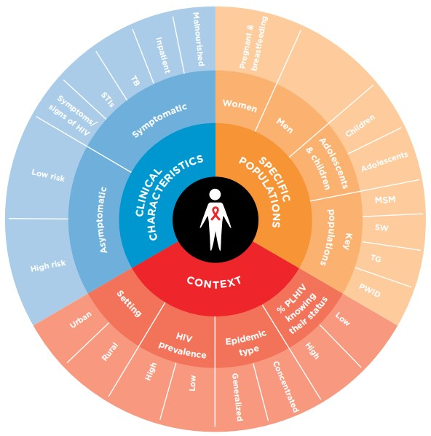
ELEMENTS AND COMPONENTS OF dHTS
COMPONENTS
Mobilizing
Mass Group, Network, Partner Notification, Index Testing
Testing
Health Facility, Non-Health Facility, Community, Self-Testing*
Linking
Referral, Accompanying, Same-day ART, Tracing

Slide 12
WHAT
Where and why to test
WHAT
WHEN
Defined time
WHEN
Clinic hours
How to link to prevention and treatment
Post-diagnosis of partner/family
HIV testing
Other screening: TB / STI / Nutrition / BP / Glucose
Special Pop Targeted time
HIVST Any time
Maternity and IPD 24h
MOBILIZING
LINKING
TESTING
dHTS BUILDING BLOCKS
WHAT
Where and how to access prevention or treatment services
WHERE
Community
WHEN
Concurrently or after HIV testing
WHO
Healthcare workers
Follow up over a defined period
Non-health & Health facilities
Home *TL
Online, Media *M
Lay cadres
Peers
Clients/family members
MLT

Slide 13
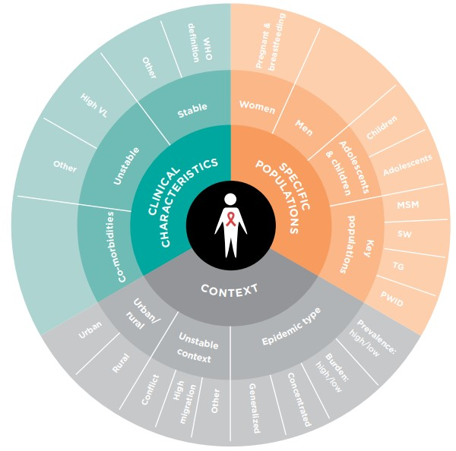
ELEMENTS AND BUILDING BLOCKS OF dART
WHAT
ART Initiation/Refill
Clinical Monitoring
Adherence Support
Laboratory Test
OI Treatment
Psychosocial Support
WHEN
Monthly
2 monthly
4 monthly
WHERE
HIV or other clinics
Hospital
Community
Pharmacy
WHO
Physician
Clinical Officer
Nurse
Pharmacist
Community HCW
Patient /Peer /Family
3 monthly
6 monthly
Home

Slide 14
dART MODELS
dART MODELS
Health Care Worker-managed
Adherence Clubs
Client-managed
Community Adherence (Refill) Groups (CA(R)Gs)
Client-Led ART Delivery (CCLAD)
Facility-based Individual
Evening quick pick-up
Weekend and after-hours treatment
Fast-track ART (+integration)
Out-of-facility Individual
Community Drug Distribution Points (CBOs and Lockers/Automated Dispensing)
Drop-in centers
Private pharmacies
Mobile clinics
Home delivery
Community Adherence Groups (CAGs)

Slide 15
TABLE OF CONTENTS
Introduction
HIV Epidemic Response: Where We Are
HIV Care Continuum
Problem Statement
Achieving Optimal Clinical Outcome
Intervention: Differentiated Service Delivery (DSD)
DSD Building Blocks
DSD Models: Prevention and Integration
DSD Model: Testing
Elements of dHTS
Building Blocks of dHTS
DSD Model: Treatment
Elements and Building Blocks of dART
dART Sub Models
Review of DSD Implementation in Nigeria
Identifying the Gap
Results Highlights
Conclusion And Recommendation
References

Slide 16
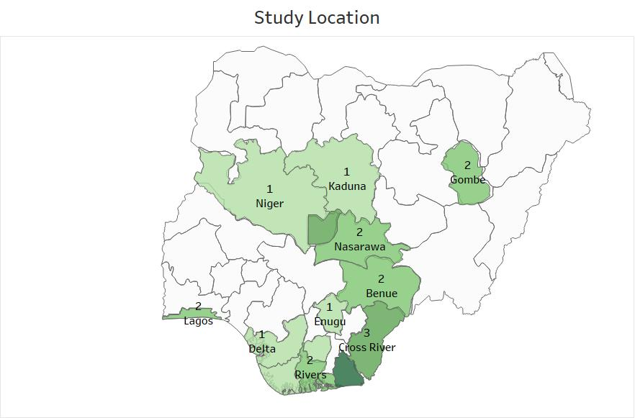
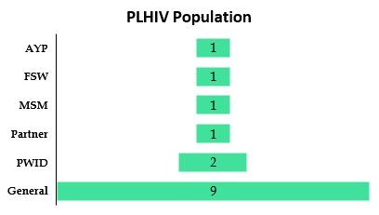
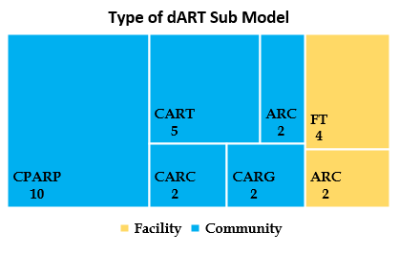
IDENTIFYING THE GAP
12 Studies
5 target groups
Children > 5 Years
Adolescents
Adults
Key Populations
Pregnant & Breastfeeding Women
36 States
+ FCT
Study Locations
Facility
7 models
INCLUDED
All studies that assessed the implementation of any DSD models at any stage in the HIV continuum of care for any population category of PLHIV
EXCLUDED
Decentralised care
Recommended DSD
Described DSD model with no assessment
Akwa Ibom -5
Bayelsa -1
FCT -3
Imo -1
Nigeria -2

Slide 17
RESULT HIGHLIGHTS
RETENTION
A progressive decrease in retention over time was recorded in all studies except Asieba et al., 2021
*proactive client monitoring and returning of clients who defaulted their appointments to facility care*
Low retention among AYPs 62.5% at 24 months
CPARP had the best retention time of 76 months
All models had optimal retention of above 95% except CARC at 12 months (86.4%)
CPARP (98.2%) and FT (100%) had the best retention
VLS
Optimally above 90%
Better in DSD (95%) vs SOC (91%)
Differentiated PREVENTION
Low uptake of screening –only 67.6%—
Lower eligibility for PrEP (32.5%)
PWID DHTS
Greater positivity among female, although more males were tested
ADHERENCE
100% in Avong et al., 2018
87.3% in Ibiloye et al., 2018
Low Viral Load Coverage
Varied Outcome
No baseline for comparison

Slide 18
CONCLUSION
The goal of DSD is to place the recipient of care at the center of service delivery while maximizing health system efficiency.
Multiple DSD models can work in parallel so that clients can move between them during their lifetime depending on their needs or evolving characteristics.
There is limited evidence on the implementation of DSD in Nigeria
RECOMMENDATIONS
More research is required to identify gaps to mitigate the high attrition found among adolescents and young people.
Rigorous evaluation is still needed to examine the impact of various DSD models on outcomes along the HIV continuum of care.
Evaluation of DSD models for the key and vulnerable population is also essential.

Slide 19
REFERENCES
International AIDS Society. (2020, 2020/011/13/). Differentiated Service Delivery for HIV Treatment: Summary of published evidence https://www.differentiatedservicedelivery.org/resources/differentiated-service-delivery-for-hiv-treatment-evidence-summaries-november-2020
United States Department of Health and Human Services. (2019a). Adherence to the Continuum of Care: Panel on Antiretroviral Guidelines for Adults and Adolescents. Guidelines for the Use of Antiretroviral Agents in Adults and Adolescents with HIV. Retrieved 2023/02/20/, from https://clinicalinfo.hiv.gov/en/guidelines/hiv-clinical-guidelines-adult-and-adolescent-arv/adherence-continuum-care
World Health Organization. (2016). Consolidated guidelines on the use of antiretroviral drugs for treating and preventing HIV infection: recommendations for a public health approach (2nd ed ed.). World Health Organization. https://apps.who.int/iris/handle/10665/208825
THE END
Thanks for Listening

